Slide 1
Intelligent modeling
Laura Dioşan
Graph-based learning
Facultatea de Matematică și Informatică
Universitatea Babeș-Bolyai

Slide 2
Graph neural networks
Why?
How?
Applications

Slide 3
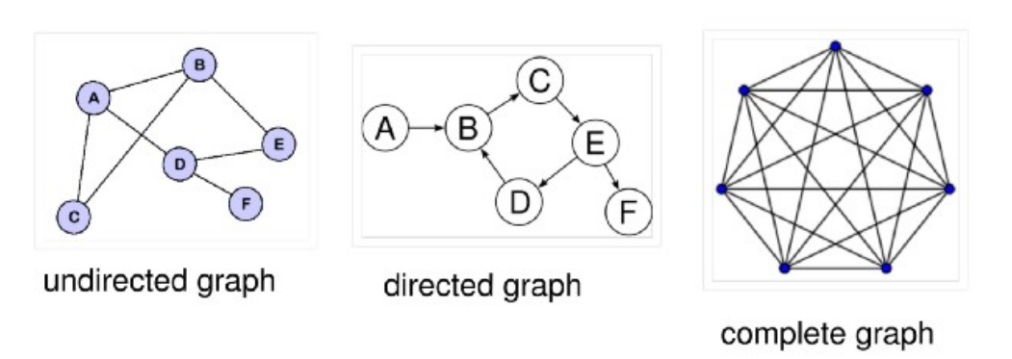
Graphs
a type of data structure having two components:
nodes (or vertices)
Homogenous
Heterogenous
edges, which connect two nodes
Unidirectional
Bidirectional
With or without weights
a graph = a collection of loosely inter-connected nodes via edges

Slide 4
Graph NNs
neural network architectures that operate on a graph.
Aim:
for each node in the graph to learn an embedding containing information about its neighborhood (nodes directly connected to the target node via edges).
This embedding can then be used for different problems like node labelling, node prediction, edge prediction, etc.
Real-life applications
Social Network Analysis — Similar posts prediction, tags prediction, and recommending content to users.
Natural Sciences — GNNs have also gained popularity in dealing with molecular interactions like protein-protein interactions.
Recommender Systems — A heterogenous graph can be used to capture relationships between users and items to recommend relevant items to a buyer.

Slide 5
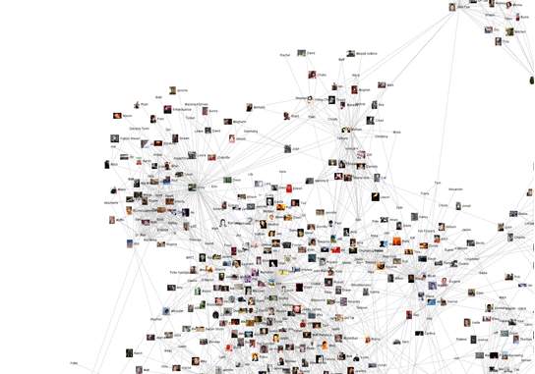
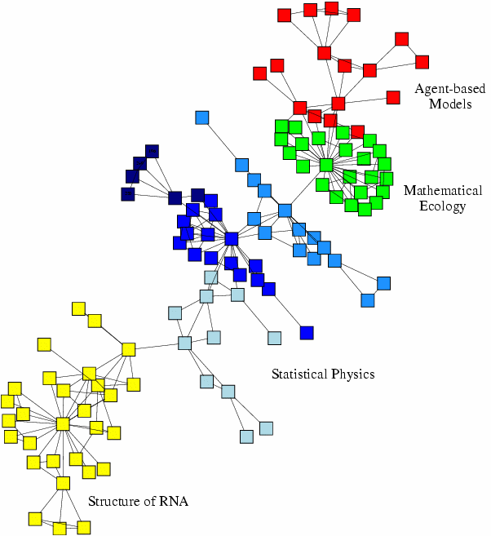
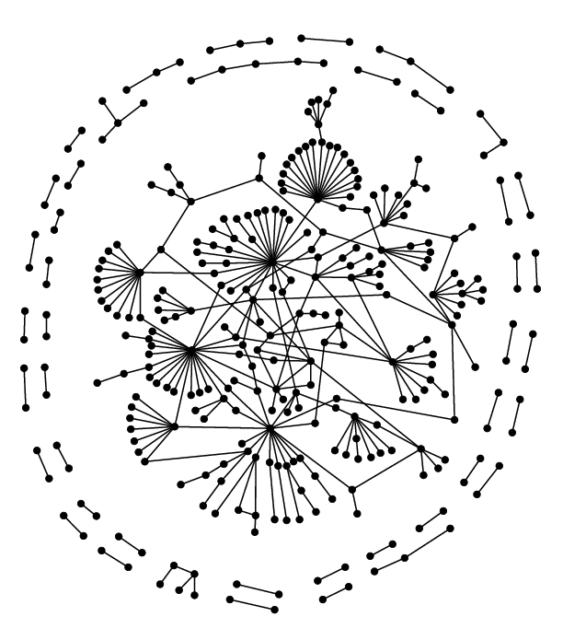
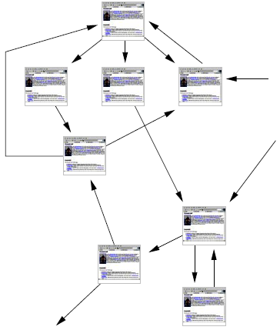
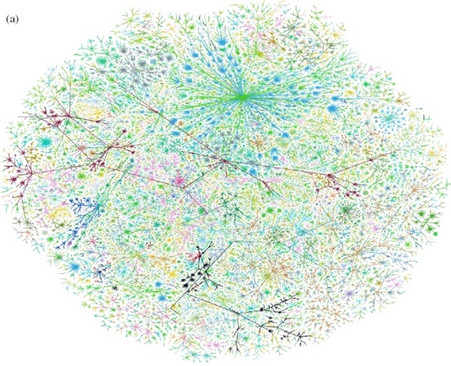
Why graphs?
Graphs (= networks, systems) are a general language for describing and modeling complex systems
Many data are represented as graphs
Social networks
Economic networks
Biomedical networks
5
Information networks: Web & citations
Internet
Networks of neurons

Slide 6
Why graphs?
Graphs (= networks, systems) are a general language for describing and modeling complex systems
Many data are represented as graphs
Universal language for describing complex data
Networks from science, nature, and technology are more similar than one would expect
Shared vocabulary between fields
Computer Science, Social science, Physics, Economics, Statistics, Biology
Data availability (+computational challenges)
Web/mobile, bio, health, and medical
Impact!
Social networking, Social media, Drug design

Slide 7
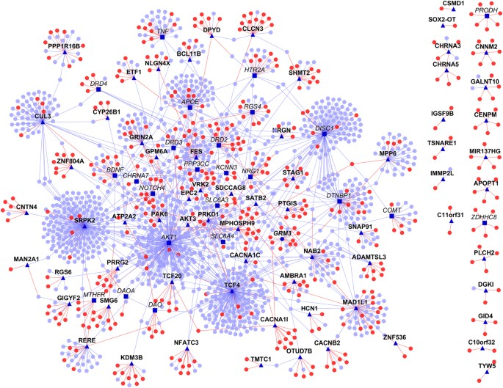

Machine learning with / in graphs
?
?
Node classification
Predict the type of a given node
Classifying the function of proteins in the interactome!
See Ganapathiraju, M. K., Thahir, M., Handen, A., Sarkar, S. N., Sweet, R. A., Nimgaonkar, V. L., ... & Chaparala, S. (2016). Schizophrenia interactome with 504 novel protein–protein interactions. NPJ schizophrenia, 2(1), 1-10. https://www.nature.com/articles/npjschz201612
?
?
Machine Learning
?

Slide 8
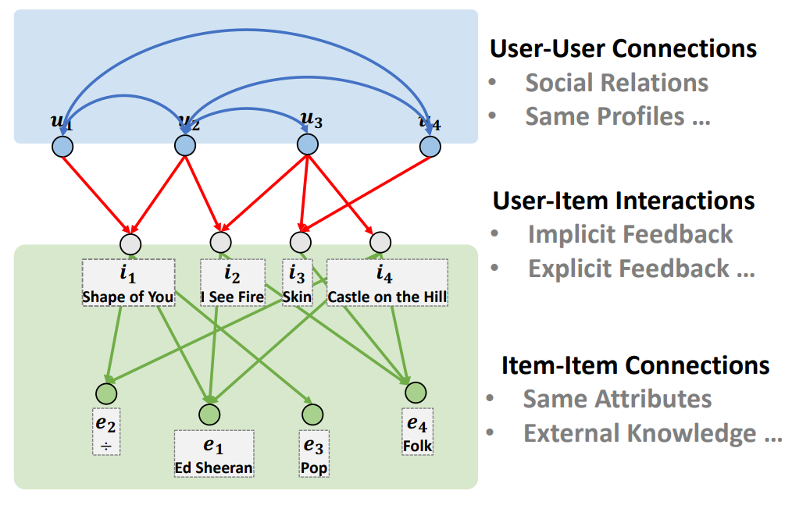







Machine learning with / in graphs
?
Node classification
Link prediction
Predict whether two nodes are linked
Recommender systems
?
x
?
Machine Learning
?

Slide 9
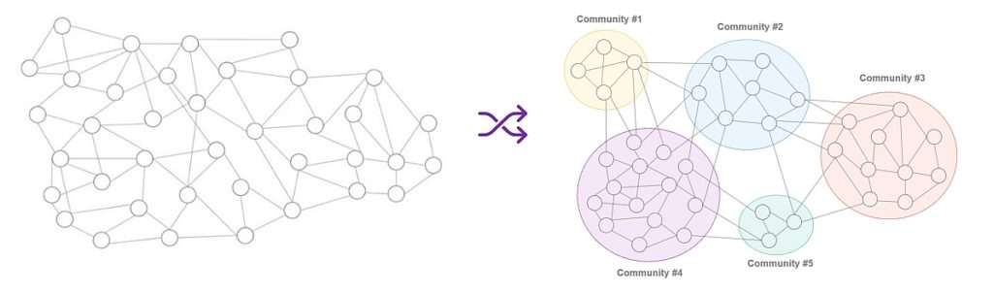
Machine learning with / in graphs
Node classification
Link prediction
Community detection
Identify densely linked clusters of nodes
E.g. Detecting communities for targeted advertising
E.g. Identifying stock groups whose share price is affected by same events

Slide 10
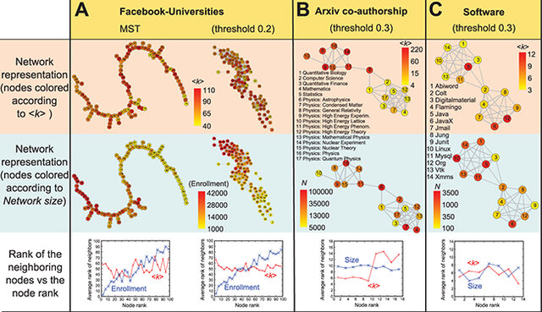
Machine learning with / in graphs
Node classification
Link prediction
Community detection
Network similarity
How similar are two (sub)networks
E.g. cybersecurity - detecting changes in the structure of a network can indicate potential security breaches or fraud. Comparing the network's current state to its previous state without knowing exact
node correspondences can help identify anomalies
E.g. Detecting structural changes in financial transaction networks can help identify fraudulent activities

Slide 11
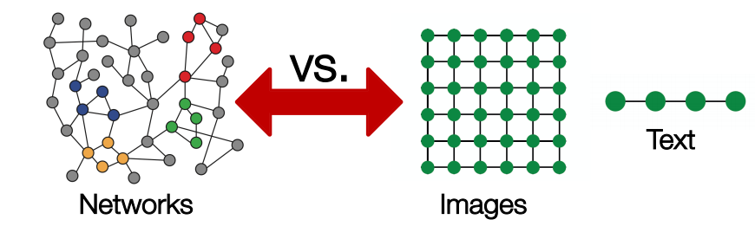
Graph neural networks
Data structures
Text/speech -> sequences -> RNN / Attention-based nets
Images -> regular grids (matrix) -> CNN
Graphs
Arbitrary size
Complex topological structure

Slide 12
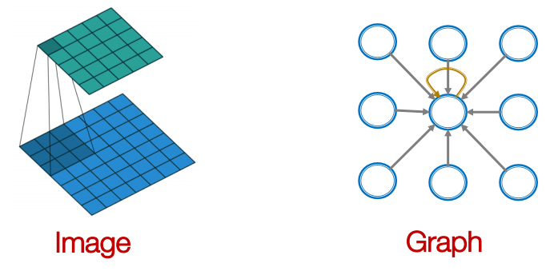
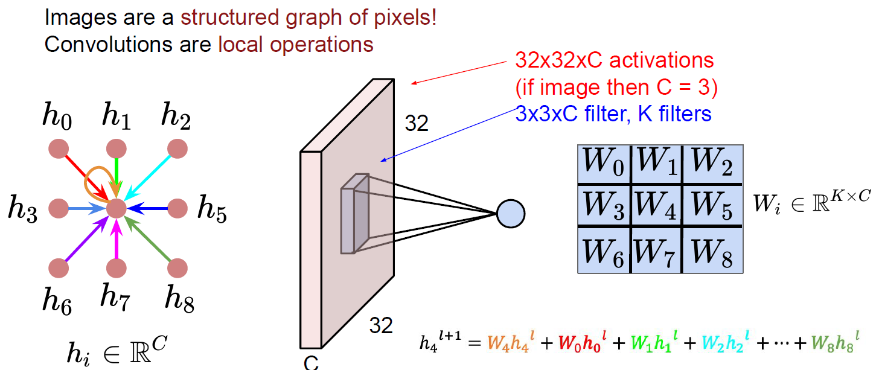
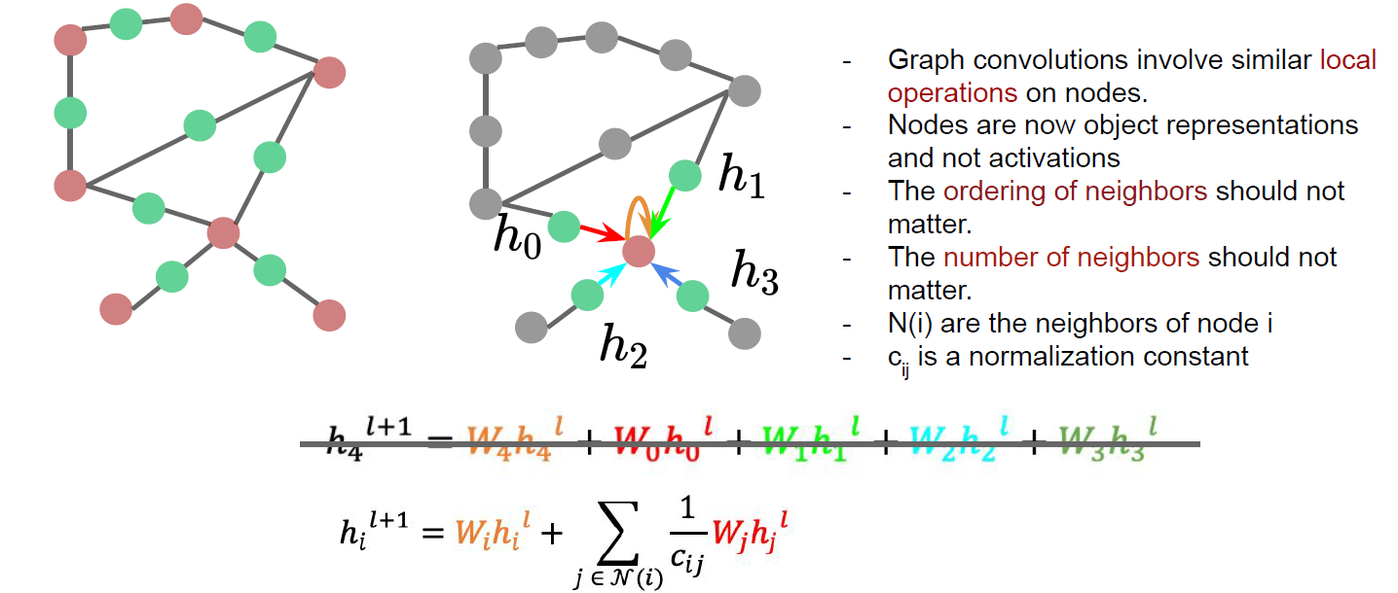
Graph neural networks
Convolutions over data
Combine the information from the current element with that from neighbours ∑w_{i}h_{i}
How to deal with more complex graphs?

Slide 13
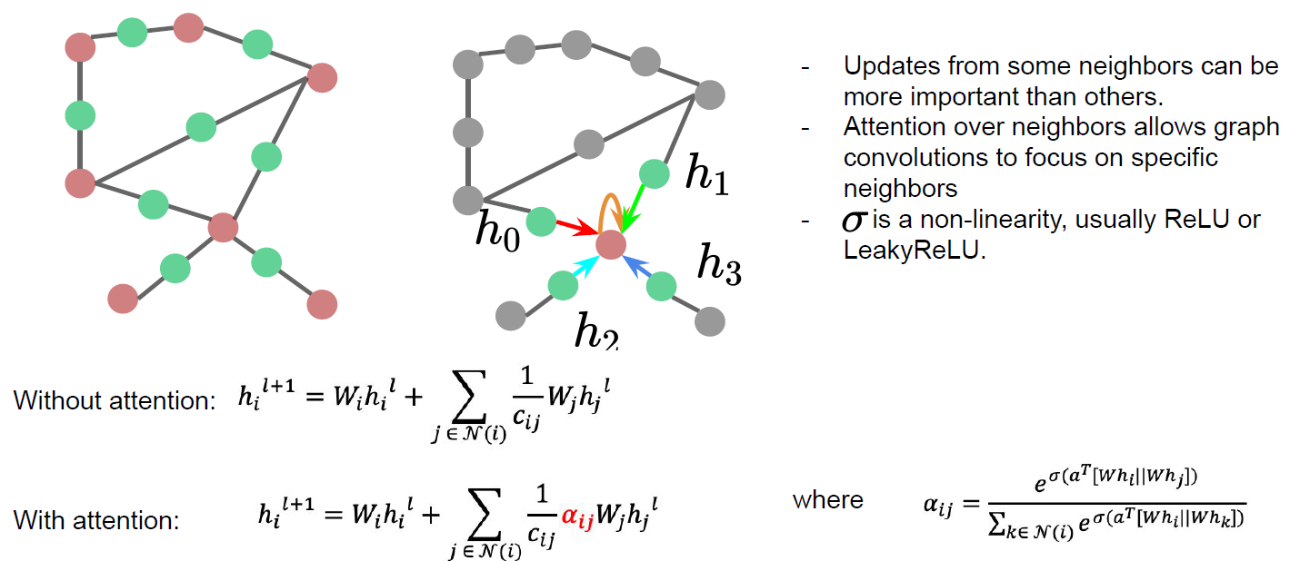
Graph neural networks
Convolutions over graphs

Slide 14
Graph neural networks
Naïve approach
A fusion between the adjacency matrix and other node features -> input for an ANN
+ easy
- a lot of parameters = O(no of nodes)
- doesn’t work for graphs of different sizes
- not invariant to node ordering
Graph convolutional networks
Node’s neighbourhood defines a computational graph
An ML algorithm is used to learn how to transform and transmit the information across the nodes

Slide 15
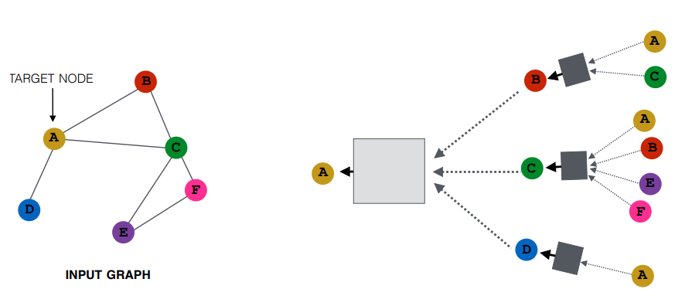
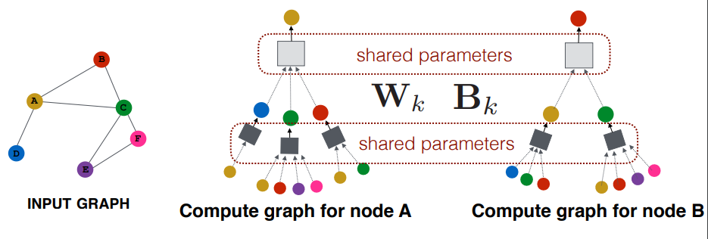
Graph convolutional networks
step1: generate node embeddings based on local graph neighbourhood
Aggregate messages from neighbours and apply an ANN
Every node defines a computation graph based on its neighbourhood

Slide 16
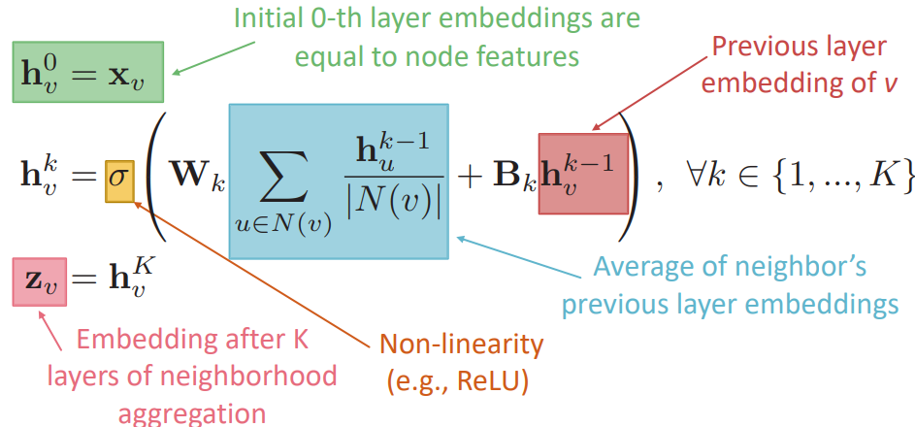
Graph convolutional networks
step1: setup for generating node embeddings based on local graph neighbourhood
Aggregate messages from neighbours and apply an ANN
Aggregation by an order invariant operator
Average (mean) or Max or Sum
ANN

Slide 17
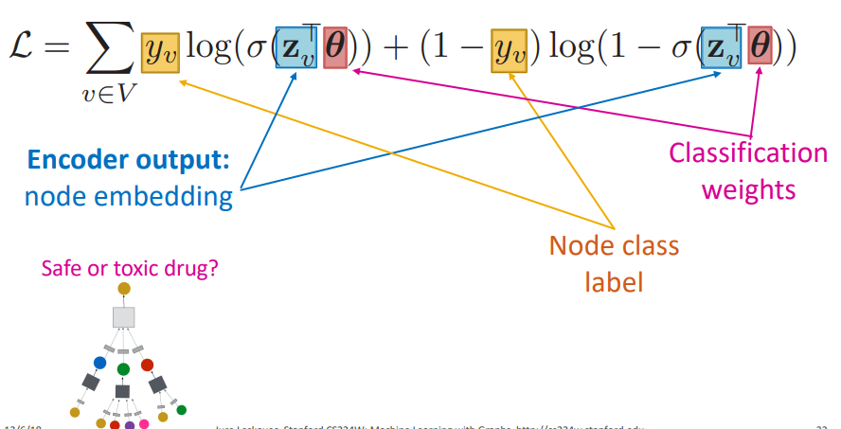
Graph convolutional networks
step2: prepare the model training
Parameters of the graph model: Wk, Bk
Classification weights θ
Loss function
E.g supervised binary classification task = safe or toxic drug
E.g. unsupervised task – random walk optimization
See DeepWalk https://arxiv.org/pdf/1403.6652.pdf
See node2vec https://cs.stanford.edu/~jure/pubs/node2vec-kdd16.pdf

Slide 18
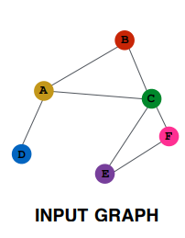
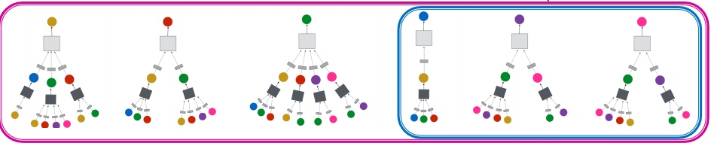
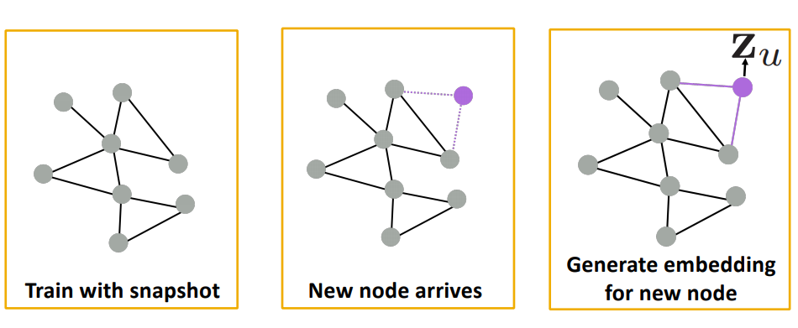
Graph convolutional networks
step3: train the model and test
Step 4: generalize for new nodes / graphs

Slide 19
Graph CNNs - applications
Action Genome: Understanding Action with Spatio-Temporal Scene Graphs
http://actiongenome.org
Ji, Krishna et al. Action Genome: Actions as Compositions of Spatio-Temporal Scene Graphs, CVPR 2020
RecSys
Pinterest - PinSage
https://medium.com/pinterest-engineering/pinsage-a-new-graph-convolutional-neural-network-for-web-scale-recommender-systems-88795a107f48
https://arxiv.org/pdf/1806.01973.pdf
Model and predict side effects of drug pairs
http://snap.stanford.edu/decagon/
https://arxiv.org/pdf/1802.00543.pdf
Data generation
Drug discovery = Molecule generation (with high value of a given chemical property)
https://cs.stanford.edu/people/jure/pubs/gcpn-neurips18.pdf
https://github.com/bowenliu16/rl_graph_generation
https://www.cell.com/cell/pdf/S0092-8674(20)30102-1.pdf

Slide 20
Additional information
Code example for GNN
https://colab.research.google.com/drive/1DIQm9rOx2mT1bZETEeVUThxcrP1RKqAn
Data
SNAP project
http://snap.stanford.edu/
Open Graph Benchmark
https://ogb.stanford.edu/
GNN and RecSys
https://github.com/yazdotai/graph-networks#tensorflow-implementations
https://next-nus.github.io/slides/tuto-cikm2019-public.pdf
Graph-based Deep Learning
https://github.com/naganandy/graph-based-deep-learning-literature
https://www.cs.mcgill.ca/~wlh/grl_book/
https://github.com/thunlp/GNNPapers
Materials are considered from various sources like:
Fei-Fei Li’s lecture about Graph Convolutions http://vision.stanford.edu/teaching/cs231n/slides/2020/lecture_18.pdf
Jure Leskovec’s Lecture about Graph NNs https://web.stanford.edu/class/cs224w/
https://www.pyg.org/
Graph Representation Learning Book, by W. Hamilton https://www.cs.mcgill.ca/~wlh/grl_book/
Network Science, by A. Barabasi https://networksciencebook.com/
…

